Slide 1

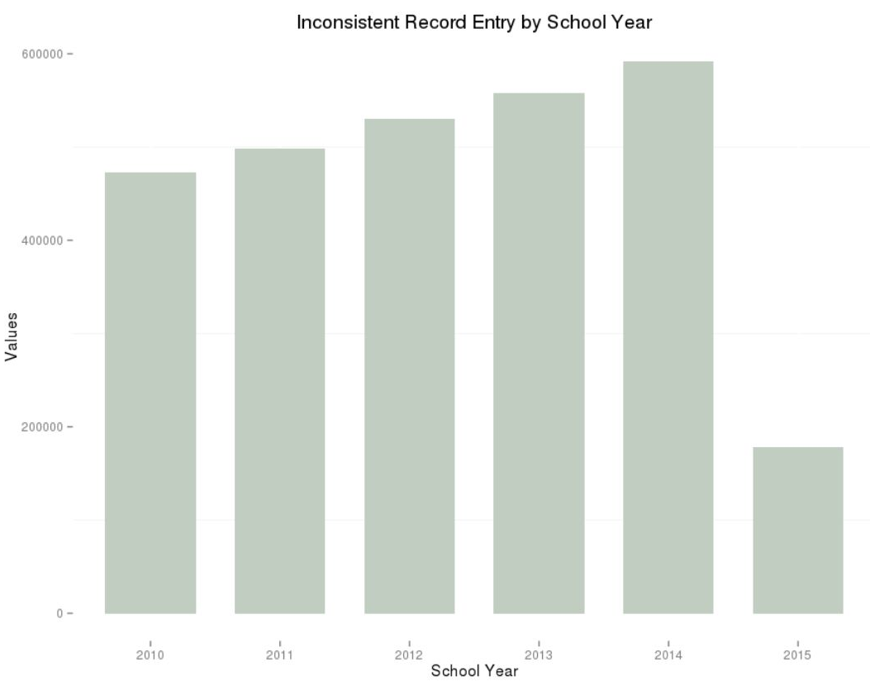
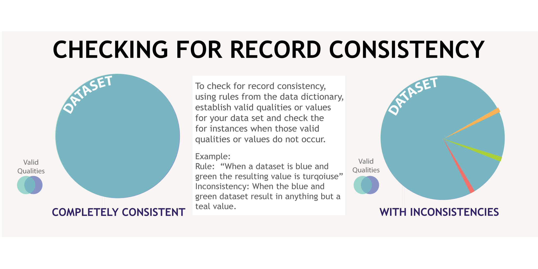
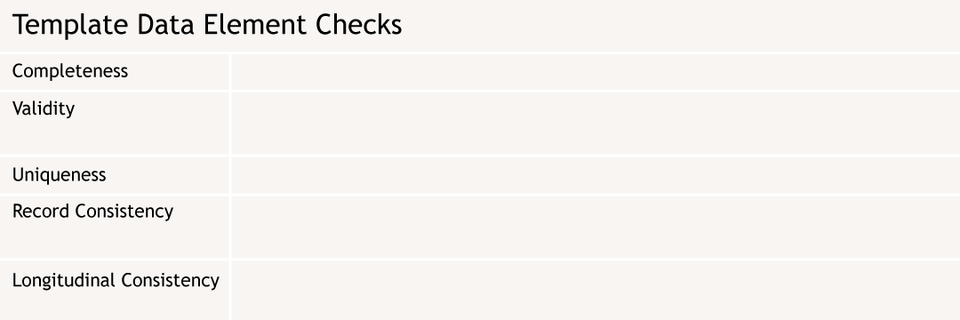
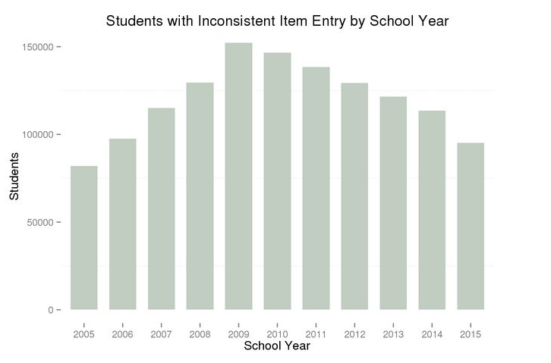
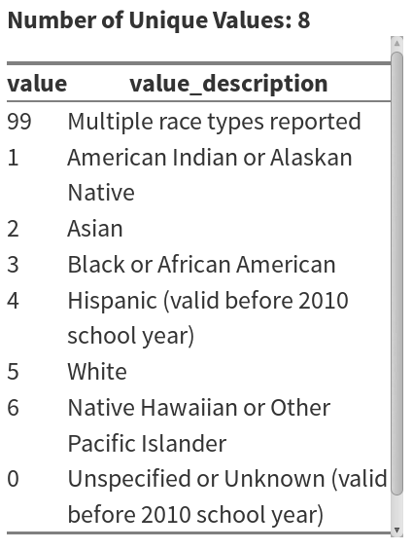
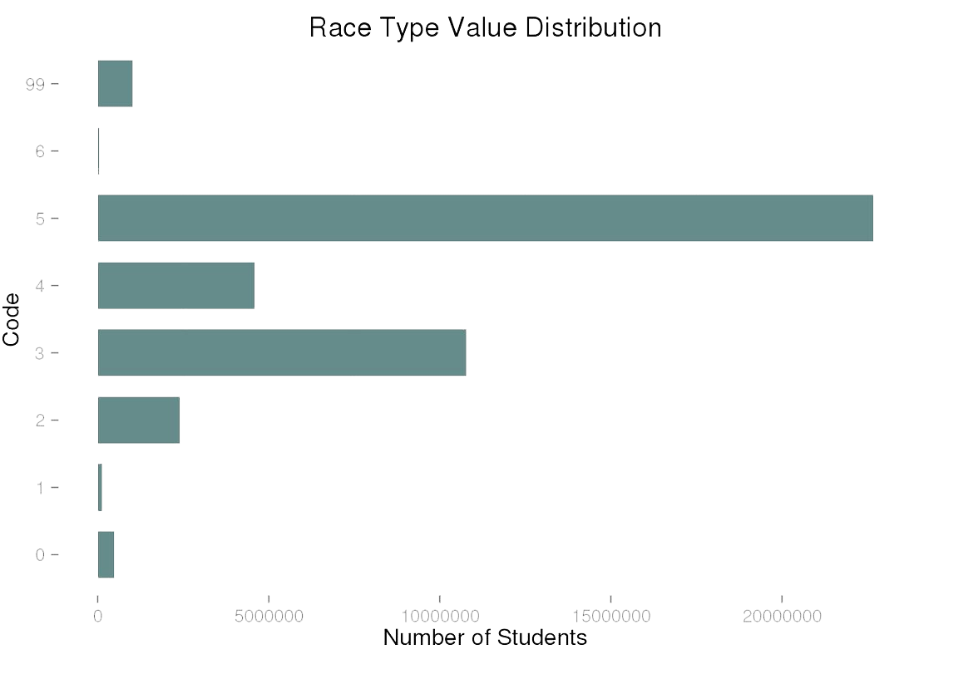
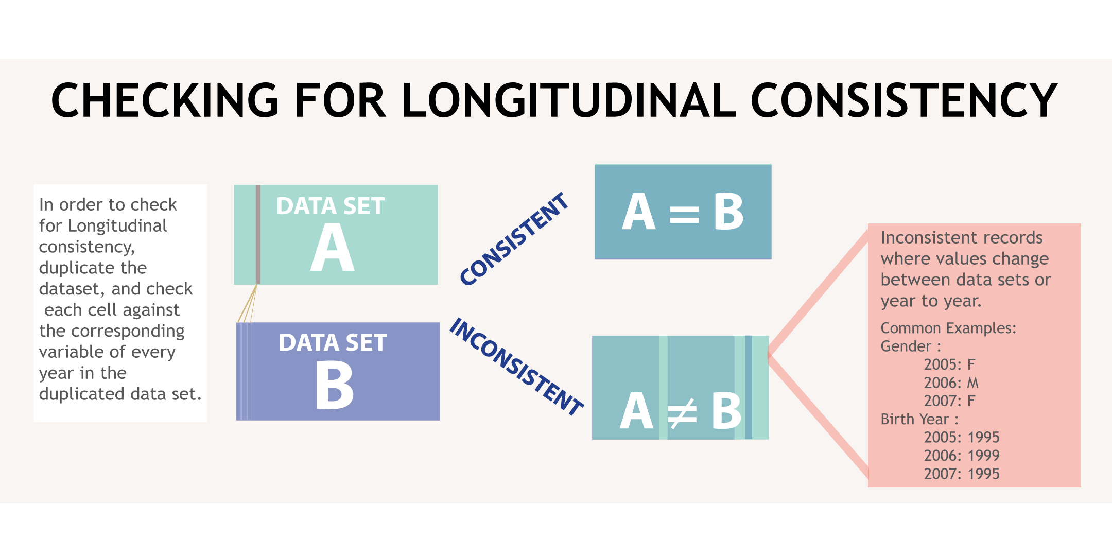

Characterizing Administrative Data Quality:
A New Tool
Data Science for the Public Good
Adrienne Rogers (Virginia Tech)
Project Team : Aaron Schroeder (SDAL), Lin Tan, Isabel Bradburn (Human Development, VT)
Overview
Nationally, states collect student records from all public schools for reporting and accountability purposes.
These data are available through statewide longitudinal data systems (SLDS).
States use SLDS data to conduct research to inform policy.
Virginia Tech (VT) developed a template to help researchers better understand the administrative data elements they are interested in and better select the data for use.
Working with the Virginia Department of Education (VDOE), VT iteratively tested and refined the template.
Student Record Collection
VLDS Data Collection reporting requirements of the No Child Left Behind (NCLB) Act. Includes student demographics, special needs information, classroom environment, etc.
Data set Summary:
Variable Count: 95 Total Record Count: 42,134,526
Creating the Template
Defining and Testing Record Consistency Rules
Creating Rules
Automating Publication
Formatting Design
Variables are often interrelated. In the case of the variable “Race Type”, certain codes cannot be used for certain school years, due to changes in the recording process. To ensure data quality, the dataset must be checked against these rules.
For “Race Type”, record consistency shows how quickly the reporting changes are catching on and being properly recorded.
  Created a set of rules for each variable in the dataset by using the data dictionary. These rules were coded using SQL.
  In order to apply the code for these rules to a variety of variables, the template was created in R Markdown to allow the user to rerun the document for different variables by only changing the ‘column name’ section.
  Using HTML code for layout and R for plots enabled a systematic, easy-to-use format
  Ex. “SELECT variable FROM data set WHERE variable IS NULL’”
  the number of missing values and the percent not null
  the number of values not defined by the data dictionary and the percent of those which are
  the frequency of unique values
  the number of records not behaving by the rules defined in the data dictionary and the percent which are behaving
  the percent of variables which remain appropriately consistent across record collection periods
“Race Type” Variable Summary Example
Testing Longitudinal Consistency
Definition: a code for the one or more races a student identifies with (often prone to changes over time)
Dates Collected: 2005-2015
During the collection period, starting with the 2010-2011 school year, the “Race Type” definition expanded to allow students to choose multiple races and separately specify Hispanic ethnicity.
In this process categories were eliminated. Eliminated categories included the ‘Unspecified or Unknown’ category and the ‘Hispanic’ category. A student with Hispanic ethnicity is now captured under the ethnic flag variable.
Due to this change, “Race Type” is one of the few variables which undergoes all data element checks, including both record and longitudinal consistencies. “Race Type” is expected to have longitudinal inconsistencies due to both the change and the nature of personal reporting.
For longitudinal studies, it is possible to see if demographic records are the same every year, e.g. age, gender, grade.
For “Race Type”, longitudinal consistency is assessed to see whether records reacted to the changes in reporting policy.
Around 2010 (the year the Decennial Census is collected), the data show the greatest number of inconsistencies and then decline steadily over time.
Acknowledgment: NSF REU, supplement to Building Research Infrastructure and Community to Advance Social Scientific and Educational Use of Administrative Data (#1338491)
bi.vt.edu/sdal

